Slide 1

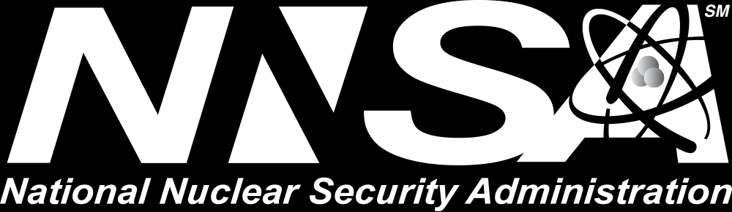
Software@Sandia

Slide 2
Windowed least-squares model reduction in Pressio
Eric Parish and Francesco Rizzi
Software@Sandia Series August 24, 2020

Slide 3

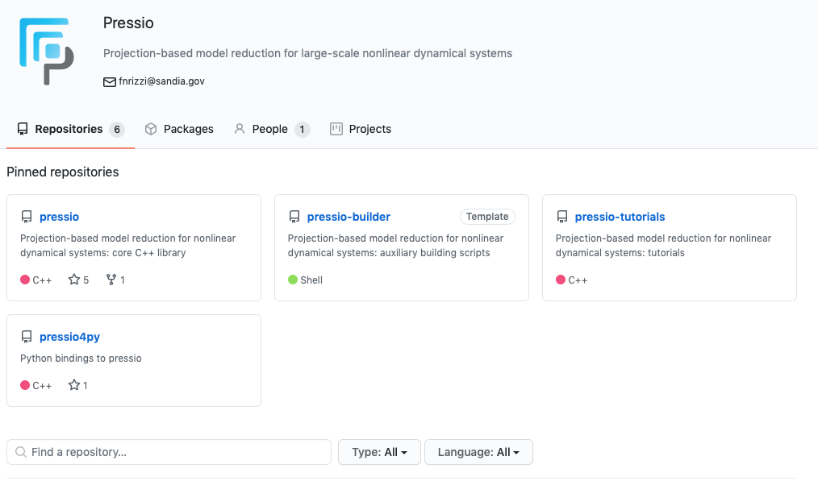
Overview
Outline windowed least-squares projection-based model reduction in Pressio
Projection-based reduced-order models (ROMs) are data-informed surrogate models
Pressio is a computational framework aimed at providing performant projection-based ROMs to generic application codes
Developed and maintained at Sandia
Roughly two years old
Has been coupled to several Sandia application codes
https://github.com/Pressio
Tutorial overview
Outline projection-based reduced-order models and the windowed least-squares method
Provide an overview of Pressio
End-to-end example of building a ROM in Pressio for the shallow water equations

Slide 4
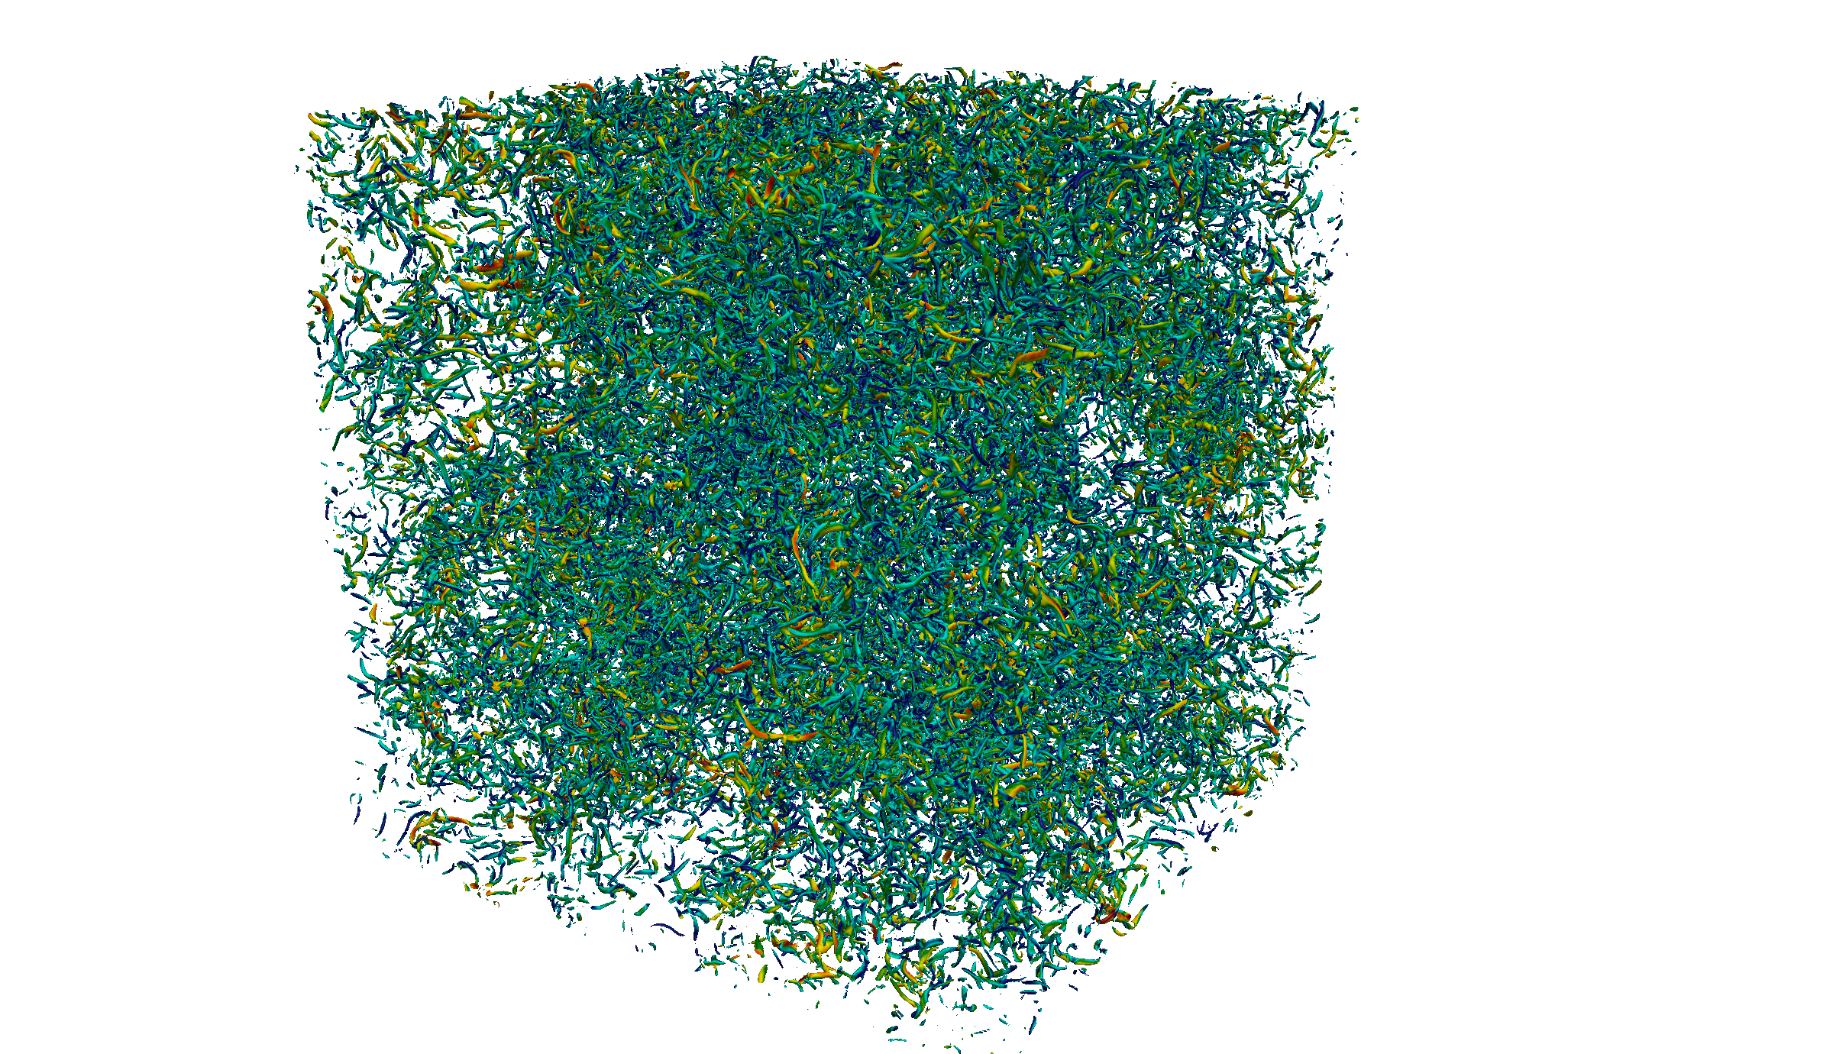
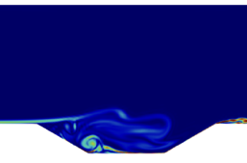
Projection-based ROMs: Motivation
High-fidelity full-order model simulations (FOMs) are ubiquitous in engineering and science
FOMs incur a prohibitively high computational cost
Can require millions of hours of CPU time
Many engineering problems are time-critical or many-query by nature
Require many evaluations of the FOM
Require low wall-clock times
Computational cost of the FOM is a bottleneck
Projection-based reduced-order models provide a solution
Enable accurate approximate solutions at a low computational cost
High fidelity simulation of homogeneous isotropic turbulence
High-fidelity simulation of cavity flow

Slide 5
What are projection-based ROMs?
Analytic basis functions
Projection-based ROMs (pROMs) are data-informed numerical methods
Similar to spectral methods
Operate by projecting governing equations onto low-dimensional data-driven subspaces
pROMs use basis functions constructed from data
Involves solving the governing equations
Other types of ROMs:
Data-centric surrogate models: create a purely data-driven surrogate model
Reduced fidelity/physics models: use coarse meshes and/or reduced physics
Spectral method
Reduced-order model
Data-driven basis functions

Slide 6
Brief description of projection-based ROMs
We focus on the dynamical system
ROMs aim to expedite the solution process
pROMs involve the following steps:
Solve the FOM to obtain “training data”
Identify low-dimensional structure (subspace) within the training data
Project the FOM onto the low dimensional subspace
Solve the pROM for new predictive cases
State:
Parameters:
Parameter domain:

Slide 7
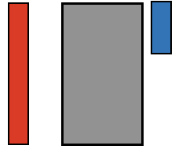
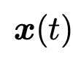


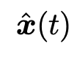
Trial subspaces: some details
Step 2: Identify low-dimensional structure within the training data
Results in identifying a low-dimensional subspace
Trial space:
Trial basis:
Results in the approximation:
Generalized coordinates:

Slide 8
Building the ROM
We approximate the state as
Insert approximation into the governing equations:
N equations for K unknowns (K << N)
Various techniques exist to reduce the system dimension
Galerkin method
Least-squares Petrov—Galerkin method (LSPG)
Windowed least-squares method (WLS)
Galerkin and LSPG can be unstable

Slide 9
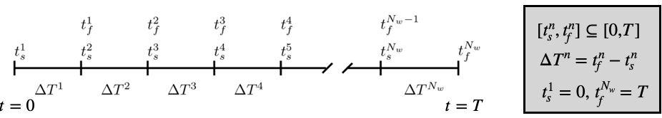
Windowed least squares ROM
Decompose the time domain into windows
Over each window, define an objective functional that measures the residual
WLS: sequentially solve a minimization problem over each window
WLS formulation yields enhanced stability over Galerkin & LSPG
In practice, WLS is solved via discrete least-squares problem

Slide 10
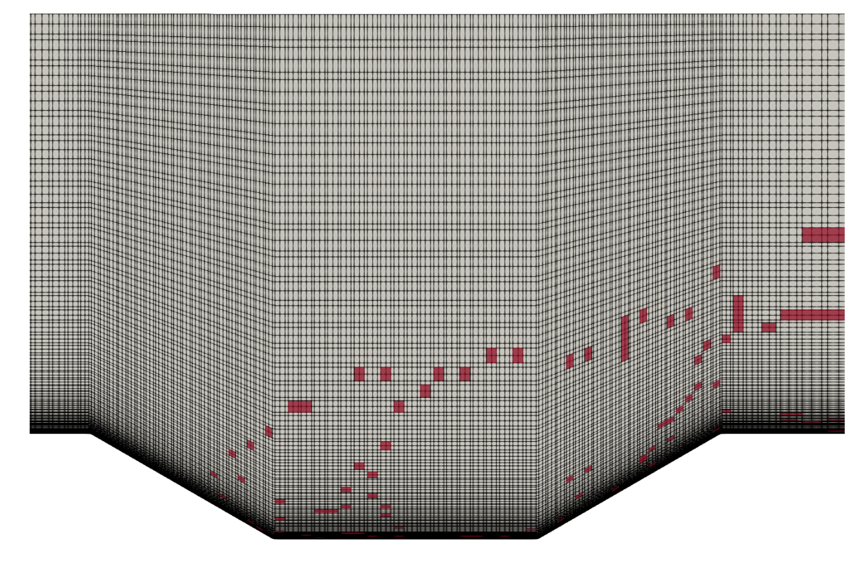
What is the ? Hyper-reduction
For nonlinear problems, pROMs are still expensive
is a “sampling” matrix that addresses this issue
Corresponds to evaluating velocity at a subset of the mesh

Slide 11
Key Challenges
Projection-based ROMs are intrusive
Commonly, ROMs are implemented directly in the application code
Highly intrusive: changes to application code
Not extensible: individual ROM implementation for each application
Access requirements: developers need direct access to application
Motivates Pressio

Slide 12
Pressio
A computational framework aimed at providing performant pROMs to generic application codes
Open source code developed at Sandia:
Lead developer: Francesco Rizzi
Team includes: Patrick Blonigan, Eric Parish, Kenny Chowdhary, John Tencer, Victor Brunini, Flint Pierce, and more
Former developers: Kevin Carlberg and Mark Hoemmen
Main idea:
Separate the “application” and the ROM
ROM methods are contained in the Pressio framework
Pressio “plugs in” to an application code
rom
https://github.com/Pressio

Slide 13
High-level features
Header-only C++11 library
Benefits portability
Leverages C++11 and metaprogramming for type detection and compile-time dispatching
Supports HPC performance portability (Kokkos)
Natively support data structures from Trillinos
tPetra
tPetraBlock
ePetra
Supports a Python API
Enables Python users to use the C++ Pressio functionalities from Python
Supports Galerkin, LSPG, and WLS ROMs (w/ hyperreduction)

Slide 14
How does Pressio talk to an application?
Pressio’s API requires the application to expose two main functions:
velocity:
applyJacobian:
rom
Pressio uses these functions to construct the ROMs
For hyper-reduction, we require velocity and applyJacobian to return results at only a subset of the mesh

Slide 15
How does Pressio talk to an application?
Pressio’s API requires the application to expose two main functions:
velocity:
applyJacobian:
Application Core Code
Adapter
int main( )
Pressio uses these functions to construct the ROMs
For hyperreduction:
Pressio

Slide 16
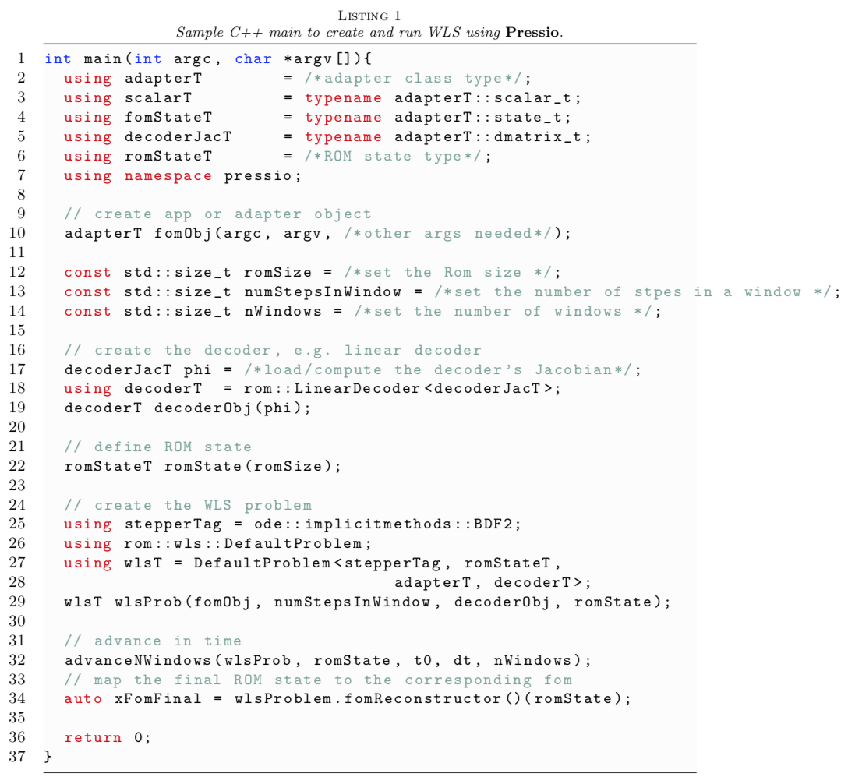
Pressio: How do we build and run a ROM?
Type detection
Create the FOM object
Load/compute the POD modes
Create the ROM problem
Advance in time

Slide 17
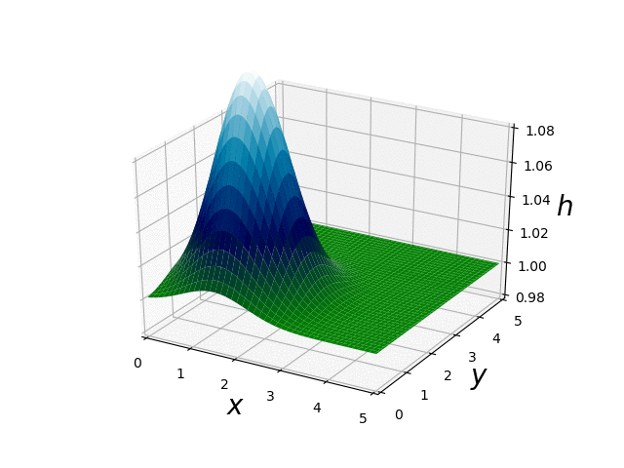
Example application of Pressio: Overview
Construct a ROM of the shallow water equations
Initial conditions
System parameters:
: gravity parameter
: controls the magnitude of the pulse
Surface plot of the water height
https://github.com/eparish1/pressio_wls_tutorial

Slide 18
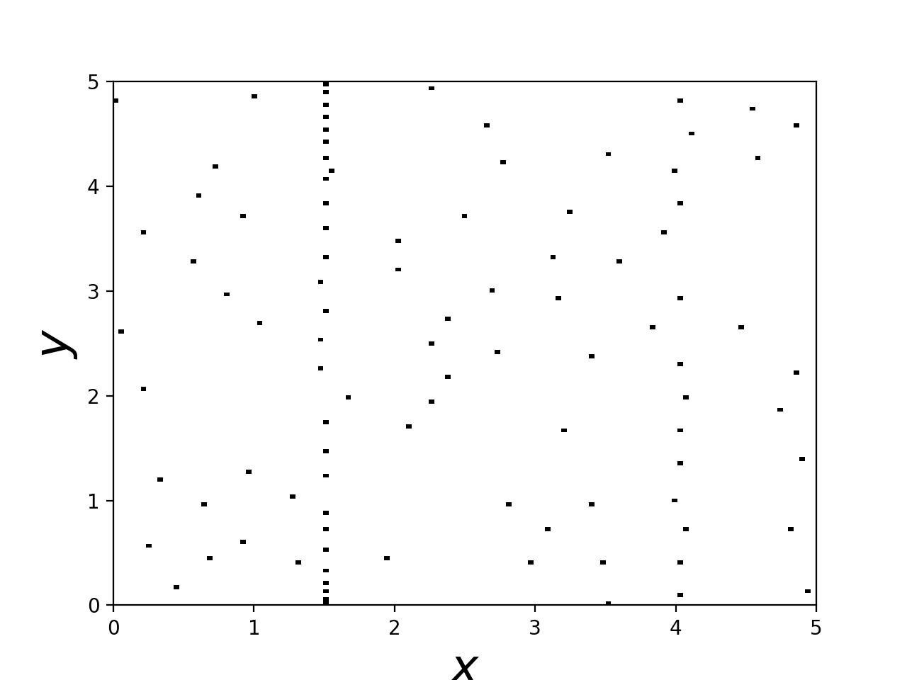
Example application of Pressio
Have access to an app that solves the shallow water equations
1st order finite volume scheme
128 x 128 mesh
tPetraBlock data structures
Capable of evaluating residual at a subset of the mesh
Takes 20 seconds to run one simulation
Add functionality for the app to meet Pressio’s API
Execute FOM for training parameter instances
Sample mesh
Post process FOM data for basis…
Execute the ROM for a test parameter instance
https://github.com/eparish1/pressio_wls_tutorial

Slide 19
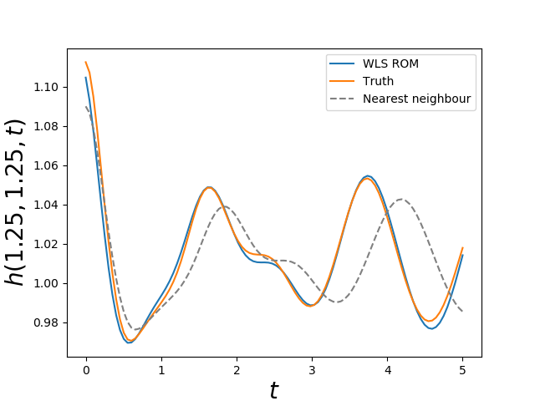
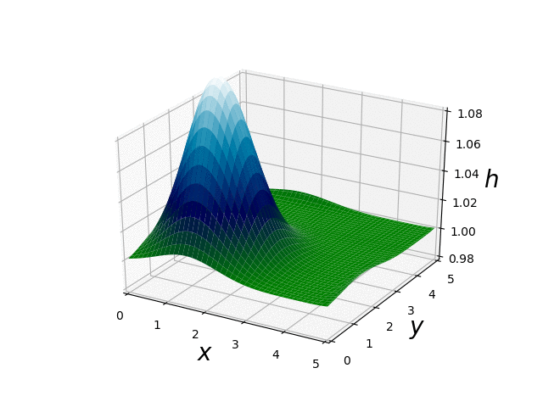
Results
Results at a novel parameter instance
0.3% error
4x speed up over FOM
6x better than nearest neighbors solution
Results improve as the FOM dimension grows
FOM solution
ROM solution
https://github.com/eparish1/pressio_wls_tutorial

Slide 20
Conclusions
Projection-based ROMs enable fast and efficient approximate solutions
The windowed-least squares formulation enables robust solutions
Pressio is an open-source framework developed at Sandia aimed at providing performant pROMs
Freely available on github
Header only C++11 library
Supports arbitrary datatypes and HPC programming models
Supports a Python API (WLS is ongoing)
We are growing the Pressio project
Coupling to new application codes
Adding new solvers and ROM techniques
Improving user interfaces and APIs
We are looking for collaborators!

Slide 21
Software Points of Contact
https://github.com/Pressio
https://github.com/eparish1/pressio_wls_tutorial
Contact email for Pressio: fnrizzi@sandia.gov
Contact email for WLS implementation: ejparis@sandia.gov

Slide 22
Example application of Pressio
Construct ROM basis from FOM data
External to Pressio
For hyper-reduction
Identify FOM cells at which to evaluate the residual
Write main file for ROM application using Pressio
Read in basis
Declare problem information
Execute ROM app and post process data
Post processing is external to pressio
Sample “main” file for WLS in pressio

